Slide 1
Keira Cricket Club Elite Team 1961 to 2011

Slide 2
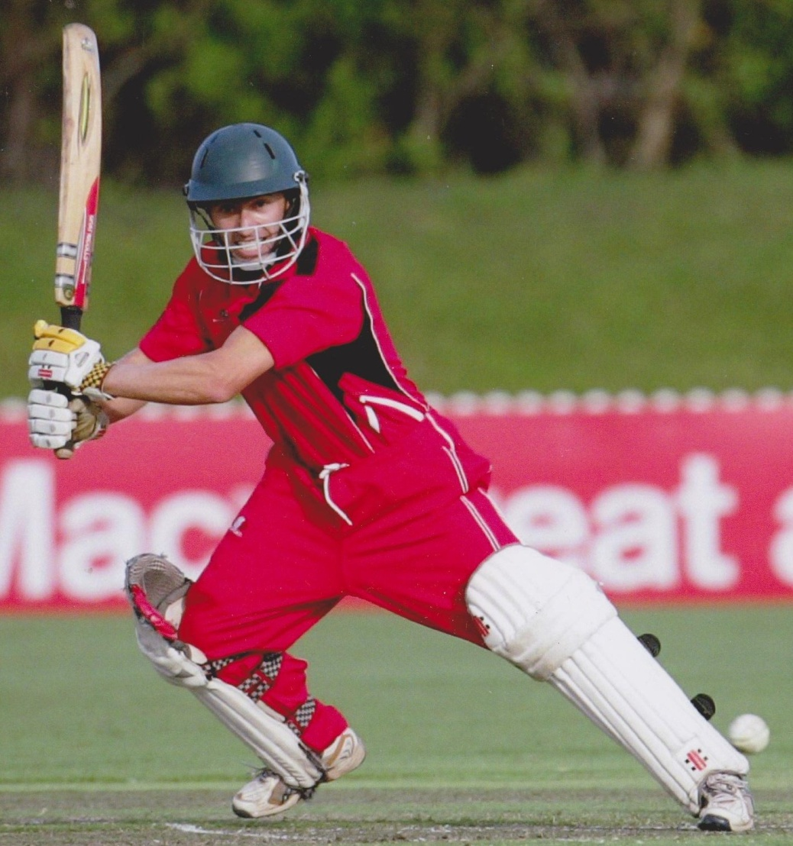
Mark Johnston 1990 - current
252 first grade matches
Left handed opening batsman
7,500+ runs, average 34, 8 centuries. H.S 131 not out
Record 1st grade aggregate 681
Captained Keira and Illawarra Seniors

Slide 3
Courtenay Lee Shoy 1990 - 1998
103 first grade matches
RH opening batsman
2,764 first grade runs, average 25.6
5 centuries, H.S 132
48 catches 11 stumpings

Slide 4
Peter Herald 1990 - 2003
121 first grade matches
LH batsman, right arm medium paced swing bowler
3,791 runs average 34.2 including 3 centuries
116 wickets. Average 22.8
Best 5 for 39

Slide 5
Don Meharg 1962 - 1984
150 first grade matches
RH batsman
4,500+ first grade runs, 5 centuries, average 22
3 centuries. H.S 157
Member of 1962-63 first grade premiership team

Slide 6
Bill Moffatt (c) 1983 - 1991
102 first grade matches
LH batsman, left arm slow medium bowler
3,284 runs at 36.9
4 centuries. H.S 133
141 wickets at 17.0
Member of 1987-88 premiership team.

Slide 7
Adrian Ezquerro 2003 - 2008
54 first grade matches
Right arm pace bowler, RH batsman
1,276 runs at 38.8. H.S 87
104 wickets at 14.5
ICA Player of the Year in 2005-06 and 2006-07
Australian Country Cricket representative 2006-7

Slide 8
Bob Fox 1958 - 1966
75 first grade matches
RH batsman, right arm pace bowler.
2,096 runs at 30.37 including 5 centuries
202 wickets at 10.1
IDCA Player of the Year in 1966
Country Representative
Member of the 1962-63 premiership team

Slide 9
Gordon McLeod (wk) 1973 - 1982
60 first grade matches
RH batsman, brilliant wicket keeper
2,082 runs, average at 23.40 including 1 century
Winner of IDCA Under 21 Player of Year on 3 occasions
Captain of Country Colts in 1977-78
IDCA Player of year in 1977-78

Slide 10
Tom Rowles 1951 - 1975
200 first grade matches
RH batsman, right arm spin bowler, wicketkeeper
3,000+ runs, average 21
2 centuries. H.S 119
100+ wickets
Best 7 for 49
Member of four first grade premierships

Slide 11
David Dobinson 1972 - 2006
197 first grade matches
Right arm medium pace and off spin bowler, RH batsman
339 wickets at 19.3
Best: 8 for 77
Winner of IDCA first bowling averages 1987-88 & 1988-89
Captain of 1987-88 first grade premiership team

Slide 12
Warren Daly 1959 - 1973
150 first grade matches
Left arm pace bowler and orthodox spinner
350 wickets at 15.9
Estimated 850 + wickets in all grades
Best: 8 for 18
Member of 1962-63 premiership team

Slide 13
Phil Vidler (12th man) 1967 - 1980
100 first grade matches
Right handed medium pace bowler, left handed batsman.
150 + wickets
Best: 8 for 33 twice! once including hat trick.
833 runs average 15

